Slide 1

The BEAM VM
A Foundation for Languages
Old and New
PRESENTED BY:
Caleb Currie
FPC Secy of Records
Slide designs licensed under CC BY 3.0 (https://creativecommons.org/licenses/by/3.0/)

Slide 2
A Special Thanks
Dr. Hume – presentation style and basics
Dr. Kosa – language design and details
Dr. Boshart – understanding the BEAM
Dr. Rogers – encouraging FP, reasonable languages and features
Dr. Ghafoor – parallelism, concurrency, scheduling and more
Dr. Siraj – how to do research, security aspects of the vm, languages
Dr. Elizandro – practicality of the systems
Dr. Eberle – developer community involvement
Dr. Talbert – ethics of presentation and research

Slide 3
Some Definitions
Virtual Machine – emulation of a computer system
Actor programming model – actors as primitives, message passing, no shared state
Concurrency – splitting into multiple tasks
Parallelism – simultaneous computation
Distributed Computing – over networks and via message passing

Slide 4
We need a roadmap?
The BEAM VM and ERTS
Erlang
Elixir
Joxa
LFE
Other languages
Basically a survey to show you what’s out there.

Slide 5
The BEAM

Slide 6
Some History
JAM → BEAM (but with much more history)
JAM - the original Erlang VM
By Mike Williams, Joe Armstrong, and Robert Virding
Written to be fast enough for actual use
CSLab at Ericsson
Bogdan/Björn's Erlang Abstract Machine
ERTS – Erlang VM (BEAM), the kernel, the standard library

Slide 7
Features
Consistent interface to the OS on all machines
Memory allocation and real-time garbage collection
Light-weight concurrency and support for thousands of simultaneous tasks
Transparent co-operation between all computers in the system
Location and encapsulation of run-time errors
Supervision of run-time code as it loads, when it is replaced, and while it is linked
One scheduler per vm thread
Like filling a box with sand, vm auto migrates processes across cores
Less work for developers, allows for more focus on problems
Hot code swapping

Slide 8
Nitty Gritty
Is a (1024) register VM with a stack
Array of Erlang Terms
158 basic instructions
Superinstructions (~450)
Each opcode has a piece of C in beam_emu.c
Directly-threaded interpreter written in C
No formal description of the VM semantics except the source code implementation!

Slide 9
Memory
4 Separate Areas / Types
Process Heaps
ETS Tables
Atom Table
Large Binary Space
Erlang Solutions has a nice tour of the BEAM
erlang-factory.com/upload/presentations/708/HitchhikersTouroftheBEAM.pdf

Slide 10
Speed, Ecosystem
BEAMJIT
Deciding at runtime to compile “hot” parts to native code
HiPE
High Performance Erlang native code compiler
OTP
Design methodology and set of libraries for building robust systems

Slide 11
Erlang

Slide 12
Erlang
Open Source Erlang
Ericsson’s Commercial Erlang
Traditional oop languages weren’t designed with concurrency as a first-class use case -Pierre Lebrun
Functional, concurrent, single assignment, dynamically typed language

Slide 13
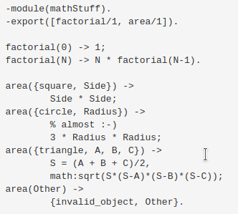
Erlang Code

Slide 14
Elixir

Slide 15
Elixir
Also functional, dynamically typed
Ruby-like syntax
BUT not Ruby for Erlang
Metaprogramming
Pipeline Operator
Protocols (Polymorphism, similar to OOP Interfaces)
Mix, Hex, community, and more!
Programming as transformation of data

Slide 16
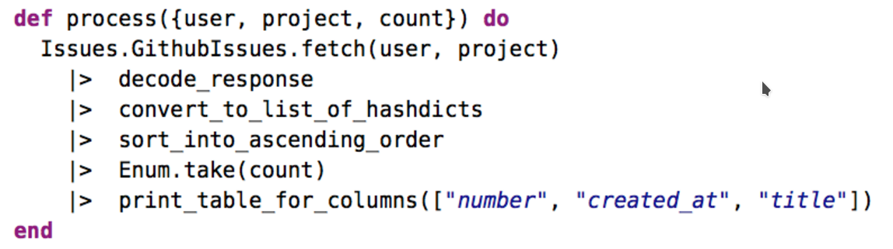
Elixir Code

Slide 17
Joxa

Slide 18
Joxa
From website - small, semantically clean, functional lisp
Not Clojure, not CL, not Erlang for sure
A Lisp-1 on the BEAM

Slide 19
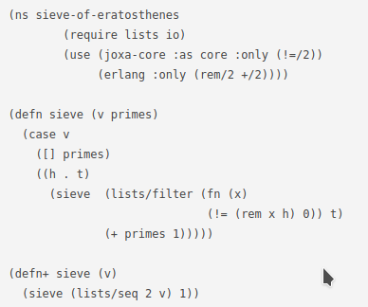
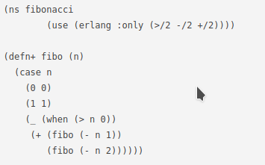
Joxa Code

Slide 20
LFE

Slide 21
LFE
Actually a lisp syntax front-end to the Erlang compiler that produces Erlang code (and has its own shell).
Is a LISP-2
Really is just what it says on the tin!

Slide 22
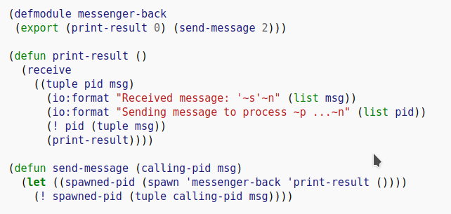
LFE Code

Slide 23
Other Languages

Slide 24
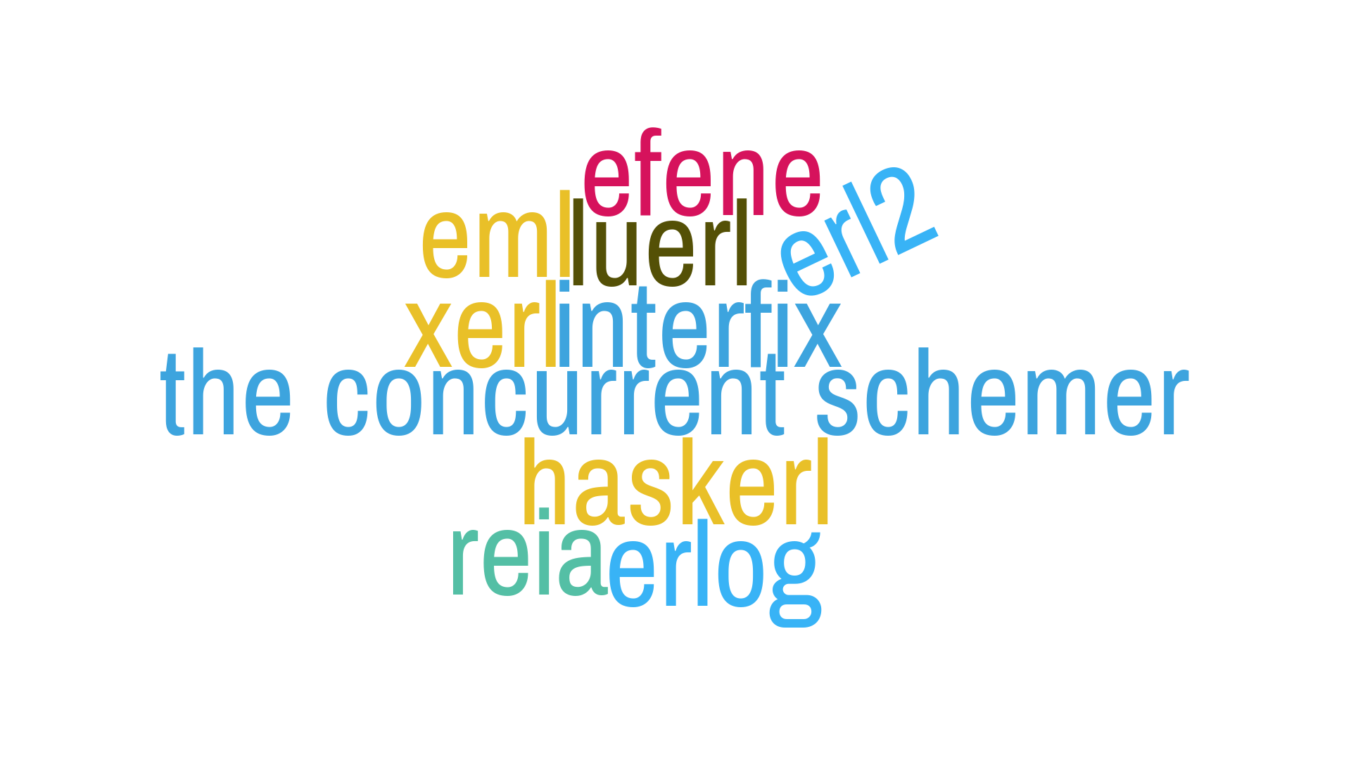
Other Languages
Lots of exciting ideas being thrown around!

Slide 25
In short...
Efene – Python Zen on the BEAM
Reia – Ruby-like on the BEAM
Haskerl – you get the idea
Erl2 – now with improvements!
Xerl – extensions!
Luerl – yes, LUA!
Interfix – expirmentation!

Slide 26
An Acive Ecosystem
HydrOS – multikernel research OS capable of withstanding complete software failure and partial hardware failure
BEAM Community & the GSOC
So many packages on HEX

Slide 27
So many ways to LEARN
Books
Tutorials
Talks
Community Involvement

Slide 28
Questions?
CONTACT:
Email: currie.j.caleb@gmail.com
Twitter: @curriejcaleb
@TTUFPC
Slide designs licensed under CC BY 3.0 (https://creativecommons.org/licenses/by/3.0/)

Slide 29
Sources
Too many to list here. Check out
https://github.com/selebrak/beam-vm-slides
https://gitlab.com/sele/beam-vm-slides
Slide designs licensed under CC BY 3.0 (https://creativecommons.org/licenses/by/3.0/)

